Slide 1
Early Christian Ireland
The Arrival of Christianity from
AD 400 onwards

Slide 2
Palladius – introducing Christianity
to Ireland before St. Patrick
Died 432; feast day formerly celebrated on October 7. The story of Palladius, recorded by Saint Prosper of Aquitaine, is caught up in that of Pope Saint Celestine I. Palladius, a deacon at Rome, was responsible for sending Saint Germanus of Auxerre to Britain in 429 to combat Pelagianism and in 431 was himself consecrated bishop of the Irish. He landed near Wicklow and worked in Leinster, where he encountered much opposition, but made some converts and built three churches. Acknowledging his lack of success in Ireland, he migrated to Scotland to preach to the Picts, and died soon after he arrived at Fordun, near Aberdeen.

Slide 3
St. Patrick
Apostle of Ireland, born at Kilpatrick, near Dumbarton, in Scotland, in the year 387; died at Saul, Downpatrick, Ireland, 17 March, 493.
[Other sources say 460 or 461.]
He had for his parents Calphurnius and Conchessa. The former belonged to a Roman family of high rank and held the office of decurio in Gau or Britain. Conchessa was a near relative of the great patron of Gaul, St. Martin of Tours. Kilpatrick still retains many memorials of Saint Patrick, and frequent pilgrimages continued far into the Middle Ages to perpetuate there the fame of his sanctity and miracles.

Slide 4
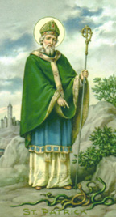
There are many and varied accounts about the life and works of St. Patrick but we do have some knowledge about him from his own writings in his ‘Confessio’
There are also many images of
St. Patrick – this one being the most popular.

Slide 5
Many Irish people went to the Continent of Europe to study in the monasteries there.
On their return they set up their own monasteries in Ireland: e.g.
St. Enda – Aran Islands
St. Kevin – Glendalough
St. Ciaran – Clonmacnoise
St Maelruain – Tallaght
St. Columcille – Derry and Durrow

Slide 6
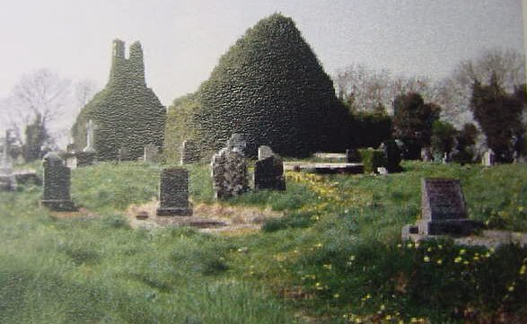
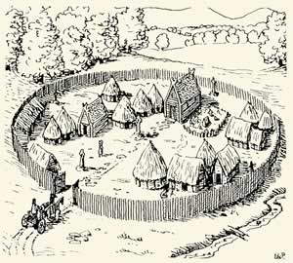
The Earliest Monasteries in Ireland were probably made from wood and therefore there is little evidence of their existance today. However written histories of the time and archaeological evidence has given us some indication of what life was like in these monasteries.

Slide 7
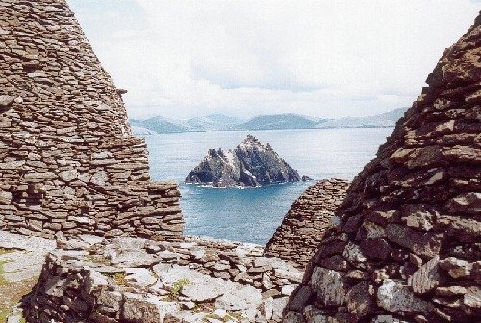
The first Irish monks were hermits and lived in isolated places e.g. Sceilg Mhicil and Inishmurray
A view of Small Skellig from the early Christian settlement at the top of Skellig Michael. The round buildings, or beehive huts, were where the monks lived and worked.

Slide 8
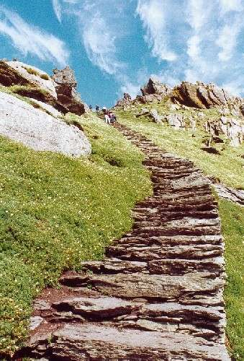
The Lower Steps on Sceilg Mhicil
Some of the 613 steps leading to the summit. The steps are uneven, of different heights, there are very few places where you can rest and there are no hand rails protecting you from the cliffs

Slide 9
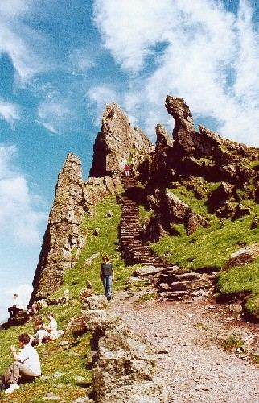
The Upper Steps on Sceilg Mhicil
The final hundred or so steps up to the monastic settlement on top of Skellig Michael.

Slide 10
The Skellig Islands, 8 miles off the western coast of Ireland's County Kerry are small, remote and dramatic. On Skellig Michael you can see the well preserved remains of an early monastic settlement.
Life was difficult on Sceilg for these monks
But many did survive the harsh conditions, feeding off fish, sea-birds and whatever small crops they were able to grow on the thin soils.
It is also probable that they received provisions from the mainland from time to time, when the weather permitted travel across the sea.

Slide 11
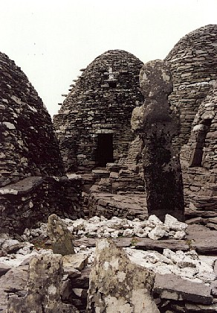
Beehive huts
The monks on Sceilg Mhicil lived in beehive huts.
These huts were weather proof as the stones fitted perfectly on top of each other – the rounded shape also meant that the rain ran off or flow off the roof and walls.
The small opening for the door allowed the least amount of wind into the hut.

Slide 12
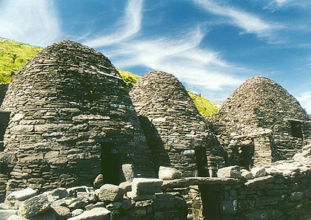
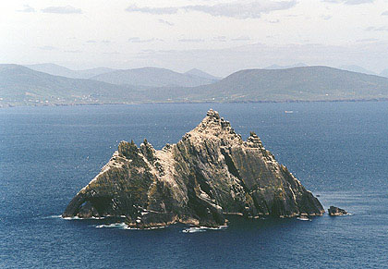
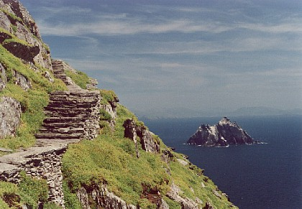
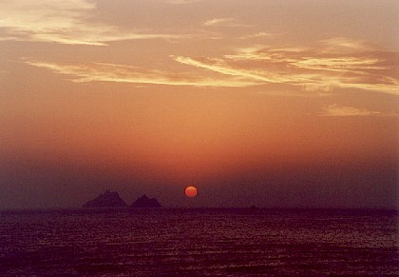
Beehive Huts
Little Sceilg

Slide 13
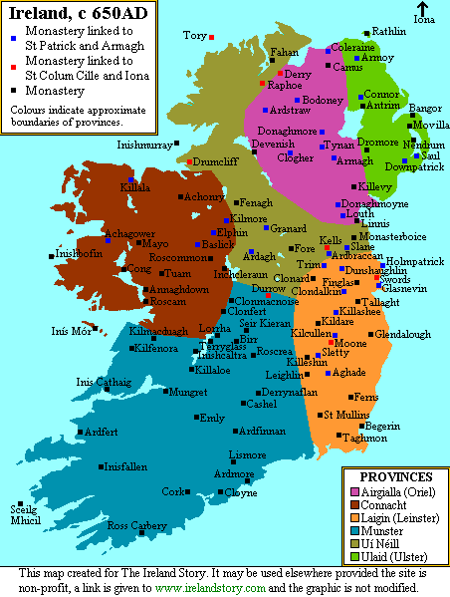

Slide 14
Irish monks and Missionary work Abroad
Columcille (521-597 A.D.)
was the Irish Celtic Monk who founded the Celtic monastery on the Island of Iona off Scotland where the Book of Kells was created, and converted the pagan Northern Picts (Northern Scots) to Christ.
He lived about 60 years after St. Patrick.
At the age of 44, Columcille left Ireland – there are many different stories told as to why Columcille left Ireland - and founded the monastery on Iona (563-5 A.D.). It was a base from which he would bring to Christianity the Northern Picts of Scotland. It became the place where the Scottish Kings received final interment. 100 years later Iona's ninth Abbot, Adomnan, would write a book called:
Life of St. Columba.

Slide 15
Not long after establishing the monastery on Iona, Columcille was preaching the Gospel on his way to Inverness, to witness to the Pictish King Brude. He was stopped by a group of Druid Priests, who demanded that Columcille and his twelve monks return to Ireland. These pagan priests claimed that Druidism was the true religion, and drew a circle on the ground, saying that Christ conflicted with the nature cycle. Columcille took his staff and drew an intersecting cross within the circle. Columcille said that God could not conflict with nature because God had Himself Created nature, and rather instead complemented it; working with it and through it.
Later, when Iona grew, wherever Columcille preached to the Picts, he would leave behind 12 monks, founding a new monastery that would become a center of Christian teaching, and eventually a Christian town. Though the Druidic Priests opposed him all the way, little by little the light of Christ covered Northern Scotland. Later, Ninian would bring Christ to the Southern Picts, and Scotland would be completely converted. One of Columcille's monks at Iona, an Irishman named Aidan, would be sent out to found a monastery at Lindisfarne, becoming the missionary monk who brought the Angles and Northern England to Christ.

Slide 16
Monastic Treasures in
Early Christian Ireland
Monasteries grew in size and wealth from AD 700.
The Monks began to create some beautiful works of art.
They used gold, silver, bronze and jewels;
The Ardagh Chalice
Tara Brooch
The Monks also produced many beautiful manuscripts
in Latin of the Gospels;
The Book of Durrow
The Book of Kells

Slide 17
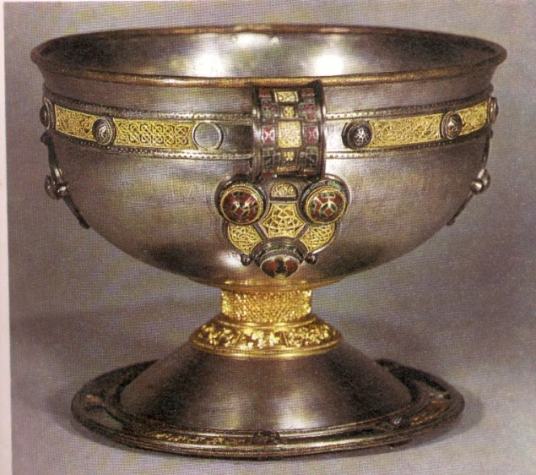
The Ardagh Chalice is made of silver and dates from around the 8th century. It is basically a hemispherical cup inspired by Byzantine design.It has two handles, held on by rivets that are disguised by studs. It is decorated with panels of gold filigree, gilt bronze and milifiori studs .The glass studs have all been individually cast. Probably a metal frame was made first and then the areas of red enamel poured in. Molten blue glass was lastly applied making the studs solid. The bands of filigree run in a band round the top, leaving large areas of plain silver which give great contrast. The Apostles names are lightly inscribed below this band, with the exception of Judas. It was discovered in the 1860s by a boy digging for potatoes! It is now housed in the National Museum, Dublin.

Slide 18
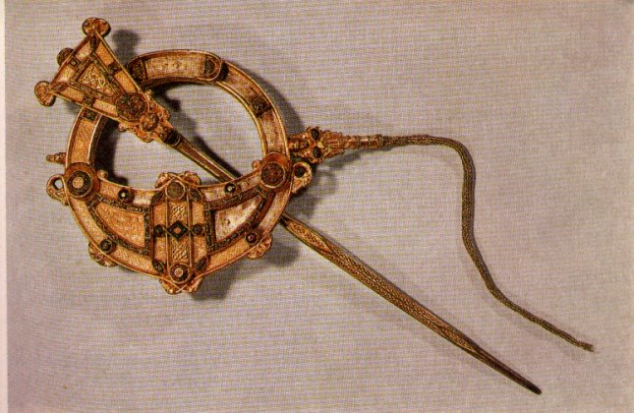
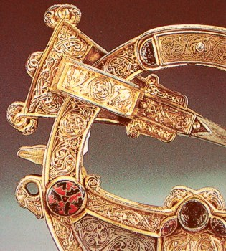
The Tara brooch is a circle of cast silver gilt covered with sheets of gold foil, and beautifully decorated with beads, twisted and plaited wires of gold, amber and glassstuds, stylised animals and spirals. All of this in a piece less than 2inches in diameter!
It dates from the 8th century approximately as does the Ardagh Chalice. These pieces were made under the new Christian influences. The monasteries at this time became greatcentres of cultural activity and wereresponsible for many of the treasures wenow regard as important pieces, the Book of Kells, Ardagh Chalice and so on.
Tara Brooch

Slide 19
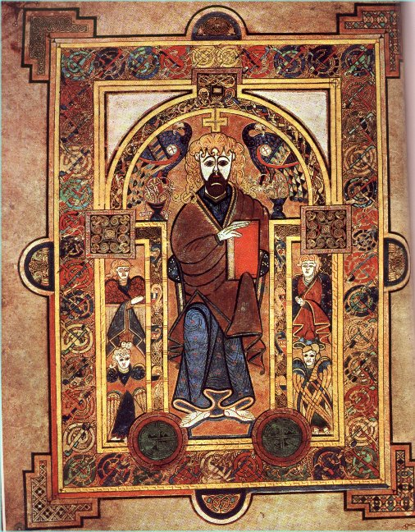
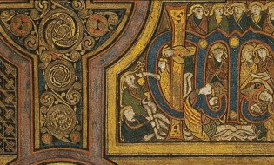
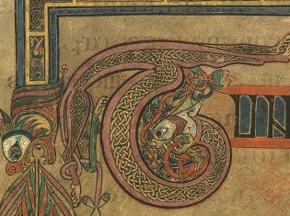
The Book of Kells
Parts of pages from the book

Slide 20
In the library of Trinity College Dublin, are kept some of the best preserved manuscripts of the 8th and 9th centuries. These were copies of the Gospel spainstakingly written and illustrated by teams of monks. The Book of Kells is undoubtedly the most famous. It was started on the Isle of Iona but completed in Kells from where it got its name. All but two of its pages are coloured. There are decorated letters and illustrations for the gospels. It along with other books such as the Book of Durrow can be seen by the public in Trinity.
One page of the Book of Kells is turned over every day.

Slide 21
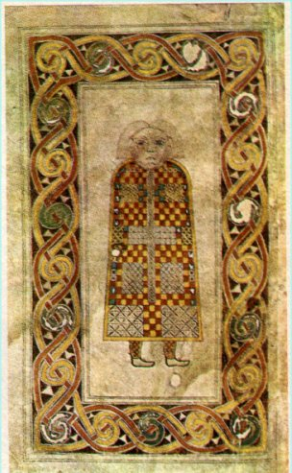
The Book of Durrow was written in about AD 675. It is one of the earliest manuscripts to have a carpet page, that is a page completely covered in pattern and colour. It disappeared from the Abbey in the 16th century but luckily was found again and had survived belonging to a farmer who used to pour water on it to cure his cattle!

Slide 22
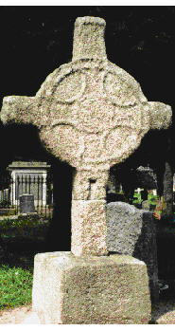
Early Christian Stone Crosses in Ireland
Monks carved and decorated stone crosses at many monastic sites. Earliest examples were just stone slabs and later the stones have arms with a circle surrounding the arms
The early Celtic Christian church developed a highly intricate art form known as the “High Cross,” which is still a popular motif in religious and funerary art and architecture. Some scholars hypothesise that it is a synthesis of the Christian cross with the earlier pagan solar symbol, the (sometimes quartered) circle.
At its highest point of development, the High Cross was virtually a sermon in stone, covered in carvings of enactments of biblical stories and symbols of Christendom. It seemed to have developed, however, from seventh-century stone slabs with intricate interwoven lacing, but without circles or biblical scenes. The circle was incorporated by the eighth century, and scenes from the Old Testament started slowly creeping onto crosses in the ninth century. By the 11th century, figures stood out of the cross in high relief on one or both of the cross faces.

Slide 23
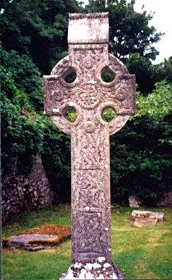
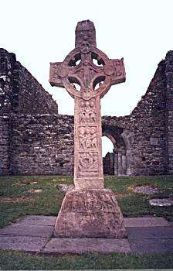
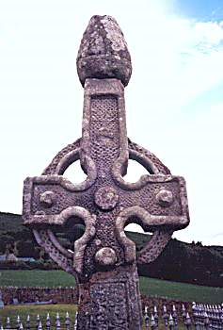
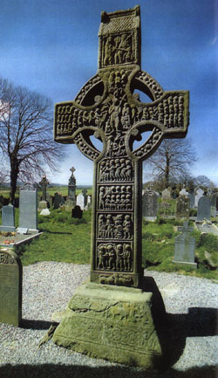
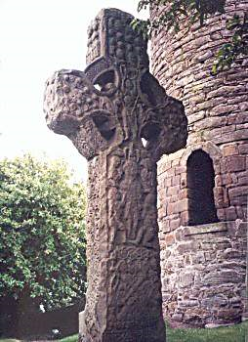
1.
2.
3.
5.
4.
Clonfert, Co. Offaly
Clonmacnoise, Co. Offaly
Faheen, Co. Kilkenny
Kells, Co. Meath
Monasterboice, Co Louth

Slide 24
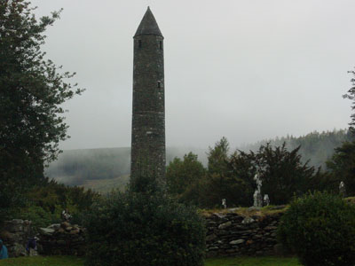
Round Towers
The arrival of the Vikings in 795 CE caught the Irish by surprise. Monasteries, which had become centres of wealth as well as learning, were prime targets for the raids. To be fair, though, many monasteries were also raided by other Irish (even by other monks jealous of religious possessions!).
This spurred Irish architects to create the
round tower. Although towers were used primarily as bell towers to call monks from the fields to prayer, it was also doubtlessly used as a defence for the monks and their treasures.
The doorway entrance was about ten or more feet above the ground, probably so that monks could climb up a rope or ladder and subsequently withdraw it. The towers are five or more stories high, with a window on each story and four windows at the top level, capped by a conical roof.

Slide 25
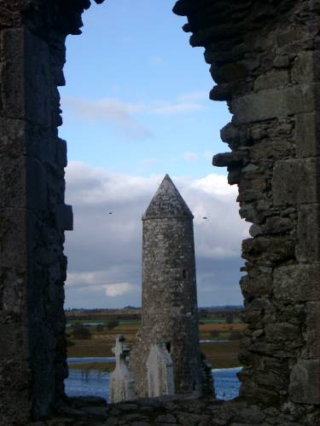
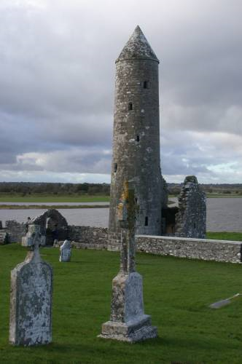
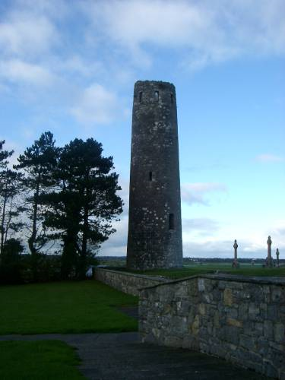
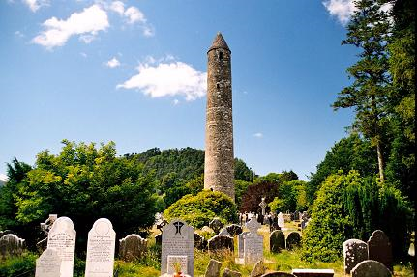

Slide 26
Round Towers were constructed in Ireland primarily in the tenth to the twelfth centuries.
Sixty-five stone towers still stand in Ireland today, and 13 of these retain their conical cap. They range anywhere from 26-35 meters in height.
Irish round towers were primarily used as belfries (cloicteach). As such they would have served various liturgical functions, such as calling the monastic community to prayer. The tolling of the bells may have warned of impending danger as well. Additional purposes, however, have also been given for the towers. Their very height and prominence in the landscape suggest that they may have been constructed as a visual representation and reminder of the power, wealth, and prestige of the monastic community. They may also have served as safes for the monastery’s treasures.
precious metal objects and illuminated manuscripts.

Slide 27
This powerpoint was kindly donated to www.worldofteaching.com
http://www.worldofteaching.com is home to over a thousand powerpoints submitted by teachers. This is a completely free site and requires no registration. Please visit and I hope it will help in your teaching.

